Slide 1
Community birthdays

Slide 2

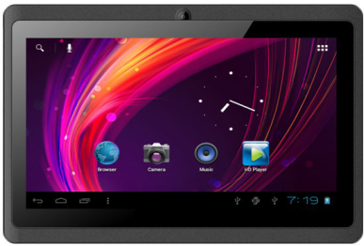
User birthday data
picture / gif
name and family
address
birthday date
App runs on HD TV screen
next birthday date
App for tablet or dongle

Slide 3
Todays row birthdays (max 4 in row)
this week row birthdays (max 5 in row)
this month row birthdays (max 6 in row)
New babys row birthdays (max 6 in row)
Rest of year 2 rows birthdays (max 6 in each row)

Slide 4
Want to work with me ?
I am an entrepreneur, and I have many apps to develop.
contact me only if you are on my bugget, and only good, fast, and honest. Try finding me on Skype :
meird054@gmail.com

